Slide 1
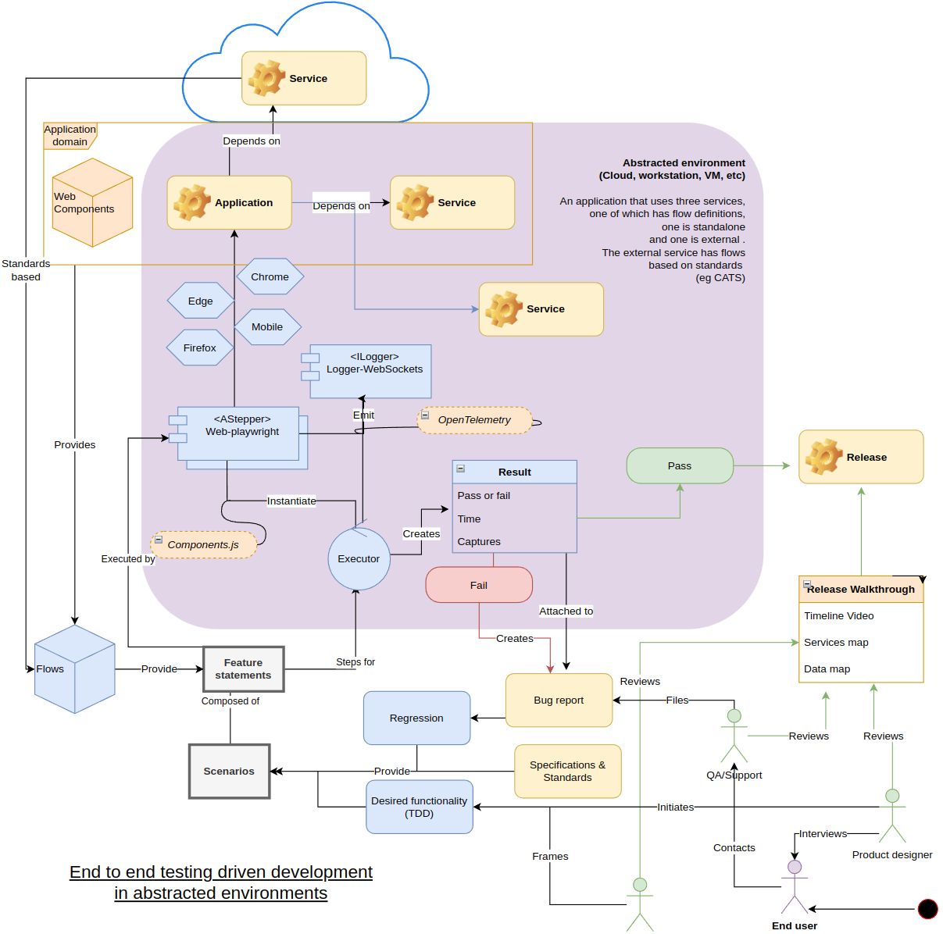
Haibun End to end test driven development in abstracted environments
Haibun for gccollab-frontend and gc wikis (github actions, pages) Feb 2, 2024
Overview diagram

Slide 2
What was done
Github actions workflow to set up frontend, run tests, publish them [1]
Set up github pages to host latest reviews (preset expiry)
Create tests for gc wikis https://docs.google.com/presentation/d/1Yemm6qJEt7Ks1CDtJ2mE6HgxZV9kaVLuyWRSJiOgPmo/edit#slide=id.g2abfb3ff6db_0_22, slide 7

Slide 3
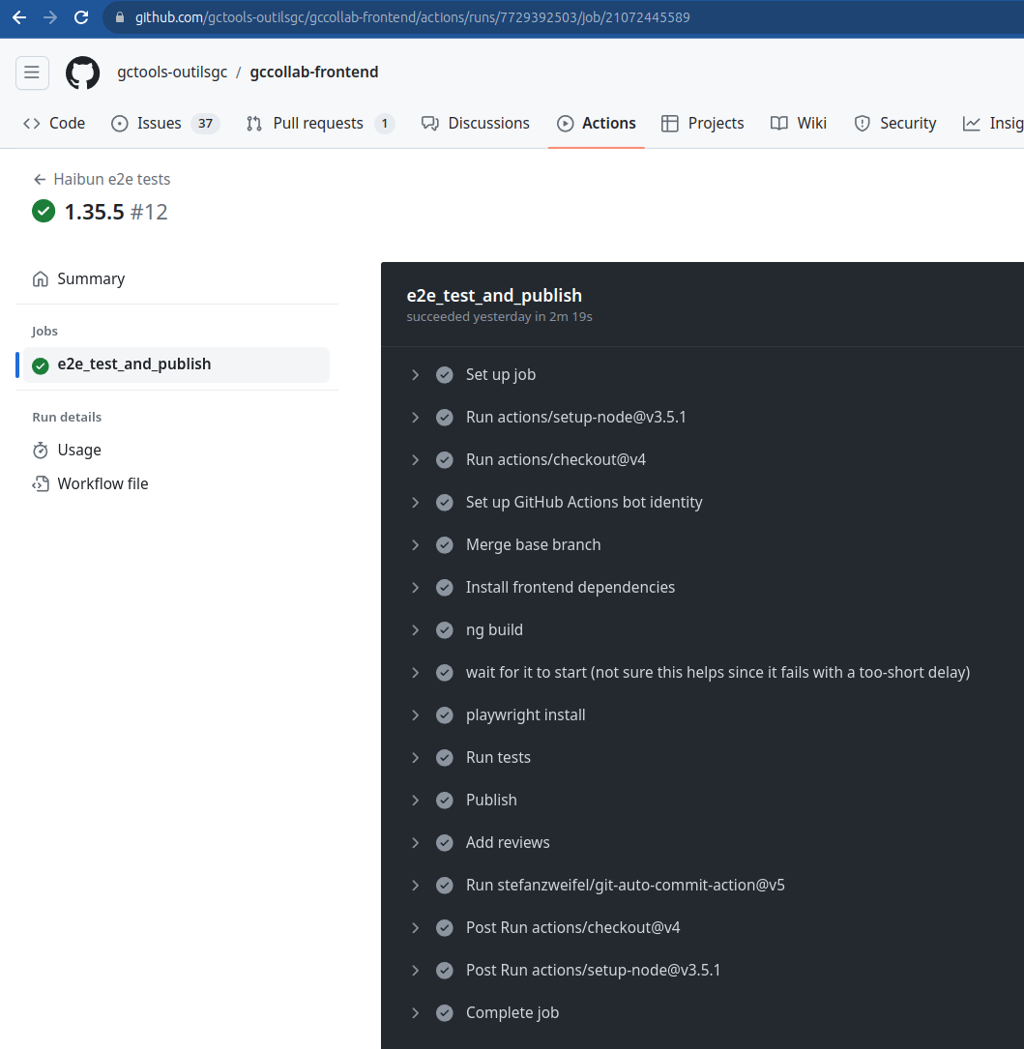
Github action https://github.com/gctools-outilsgc/gccollab-frontend/actions/runs/7729392503/job/21072445589

Slide 4
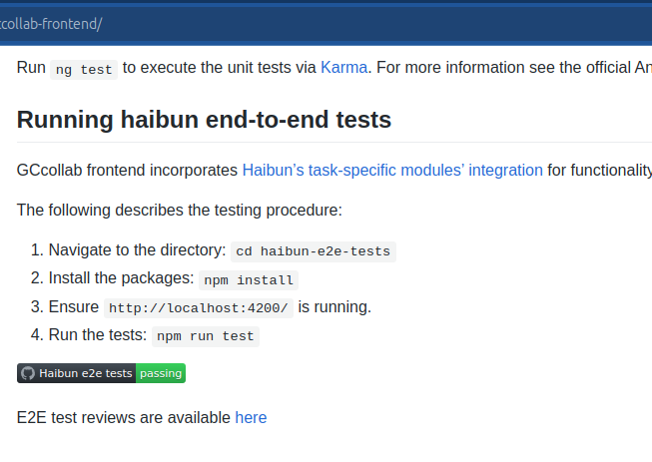
Github pages
https://gctools-outilsgc.github.io/gccollab-frontend/
Use github pages site as info for project
& to host test reviews, updating documentation (demo)

Slide 5
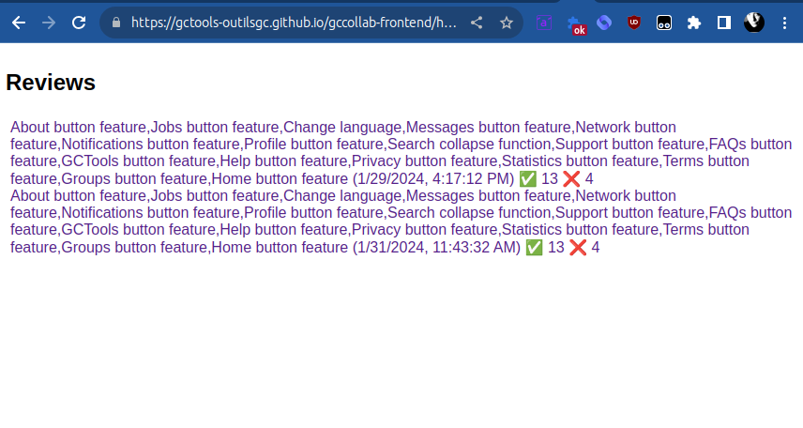
Github pages
https://gctools-outilsgc.github.io/gccollab-frontend/haibun-e2e-tests/reviews/dashboard.html

Slide 6
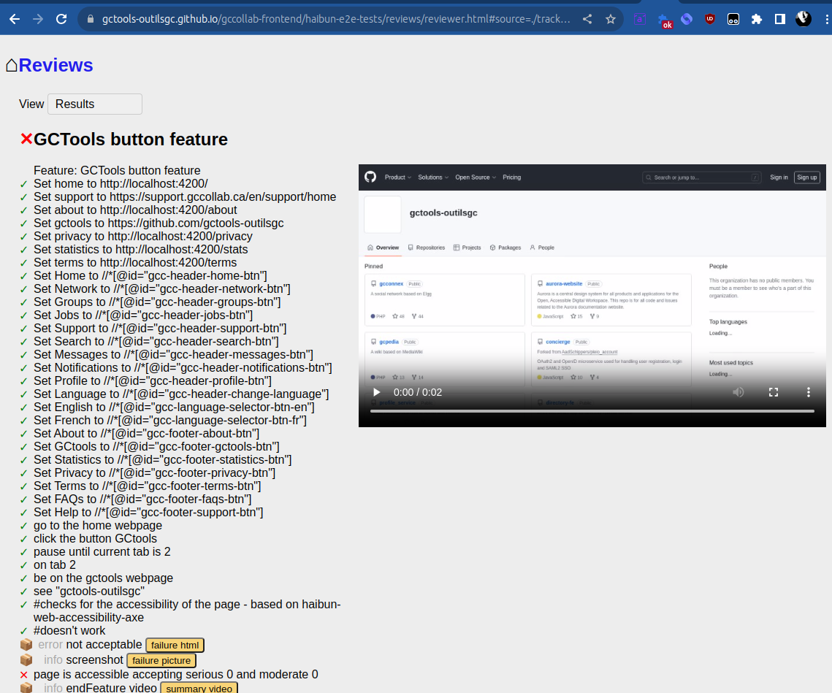
Github pages
Interactive review

Slide 7
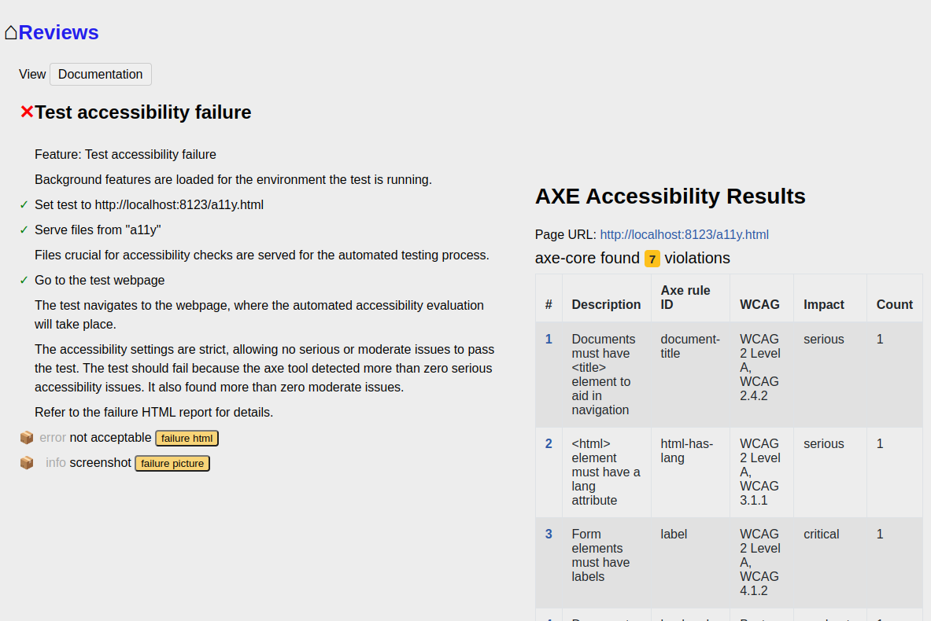
Review artifacts

Slide 8
GCPedia test
Feature: Account Creation Workflow on Wiki
Backgrounds: account
Scenario: Navigating and creating an account on a local Wiki page
We start by creating a random username and password, and what will become the user page.
When I have a valid random username <username>
When I have a valid random password <password>
concat "User:" and <username> as User page
Go to the create account page, and fill it in, starting with the gc institution.
go to the "http://wiki.local/Main_Page" webpage
resize window to 1400x1100
then click by text "Create account"
input <username> for Institution email
We have to wait a moment to get the form to recognize the name and institution have been entered, so it will populate the username field.
pause for 1s
Press "Tab"
Type "c"
input <password> for Password
input <password> for Confirm password
input "test account" for Real name
Click the checkbox Accept terms
Click on Create account
Now the new user has been created, there should be an announcement popup with this information.
Follow the link.
In Notification title, see "User page Created"
Click "here"
Confirm we're on the new user page.
URI case insensitively matches User page

Slide 9
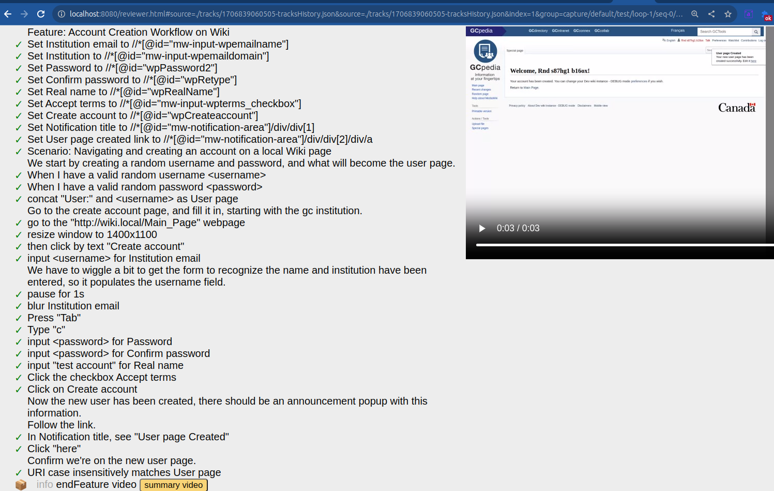
GCPedia test (demo)
https://github.com/gctools-outilsgc/gcpedia/issues/215

Slide 10
What do we have now
Open-ended local & pipeline e2e tests for new gccollab, wikis
Basis for flows: language with account creation, …
Reviews
Test functionality, accessibility, …

Slide 11
What’s next
Tests
Finish gc wiki tests, add to pipeline
Expand tests
Functionality
Test recorder
Maps between applications
Updating / verified documentation view

